Slide 1
$whoami
“Building Secure Foundations: My Path in CS, Cybersecurity, and Platform Engineering”
Jaynor Neiva

Slide 2
1
Background
2
Current Life
3
Future Goals

Slide 3
How many of you have played video games in the past?

Slide 4
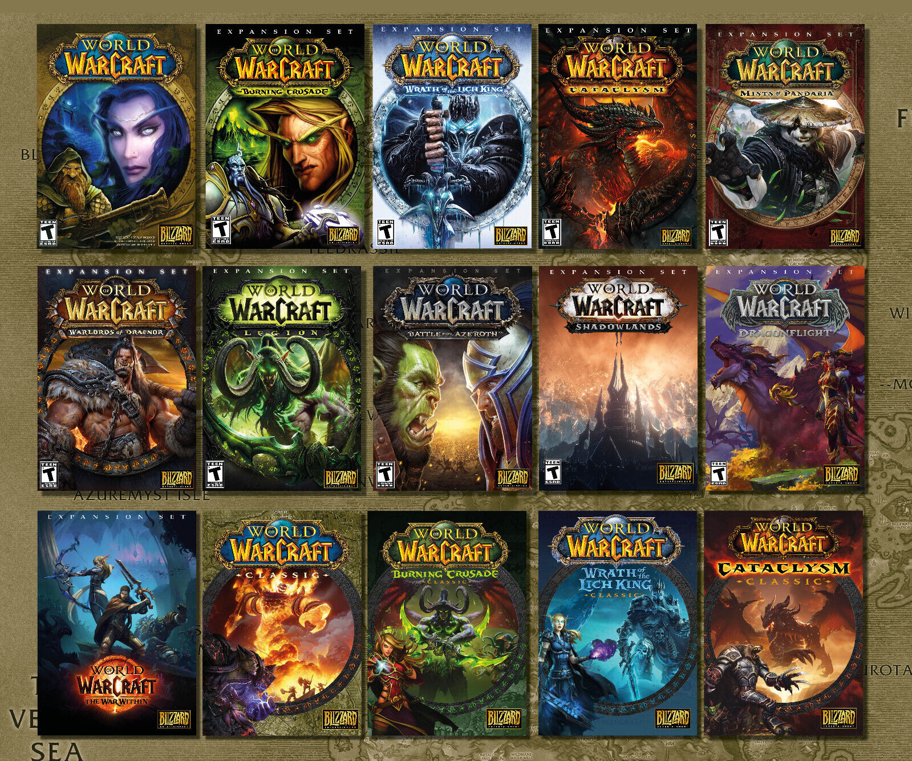
Background
Game Hacking
Web
Botting

Slide 5
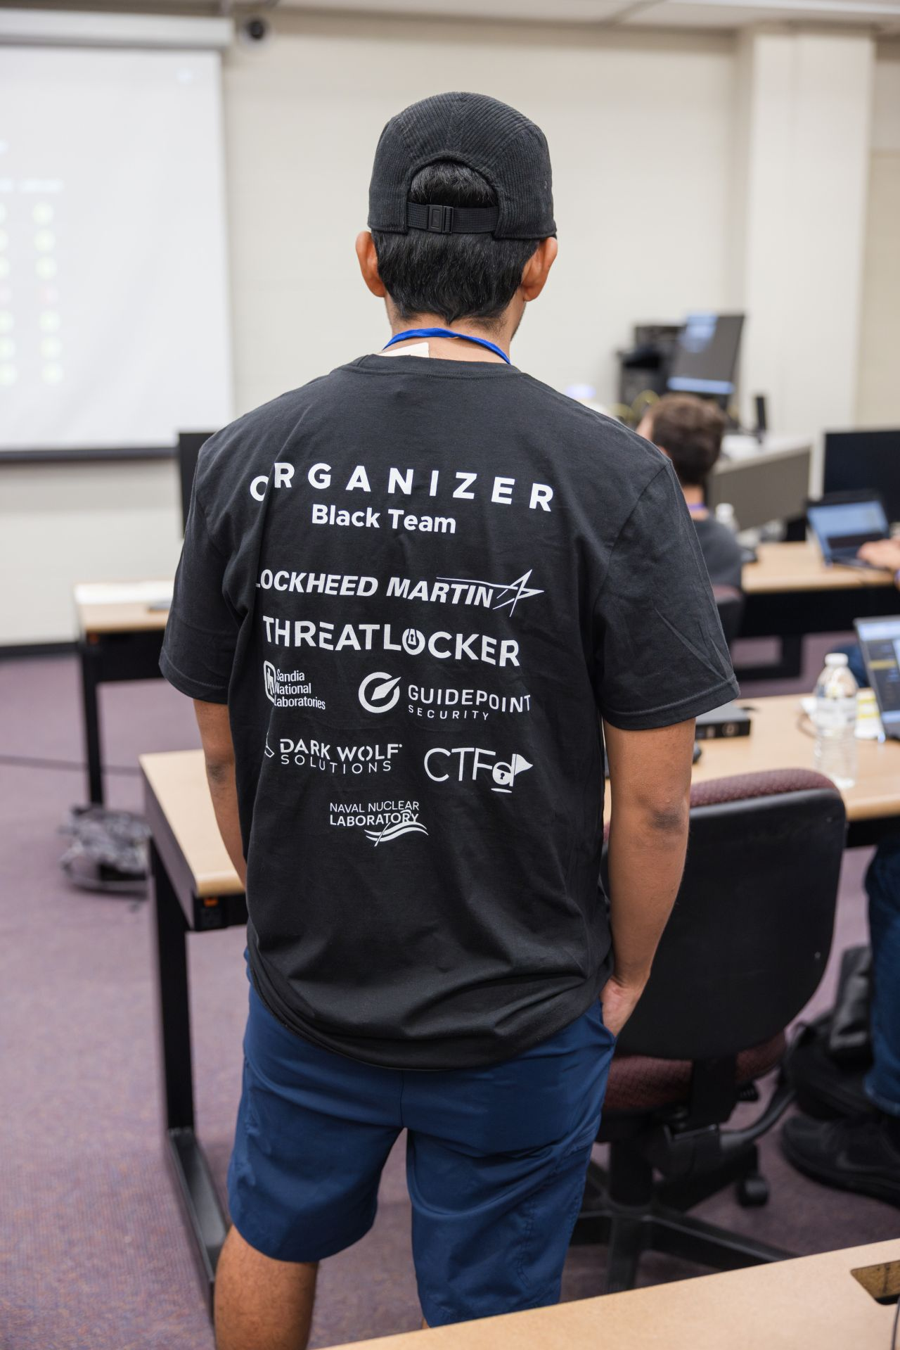
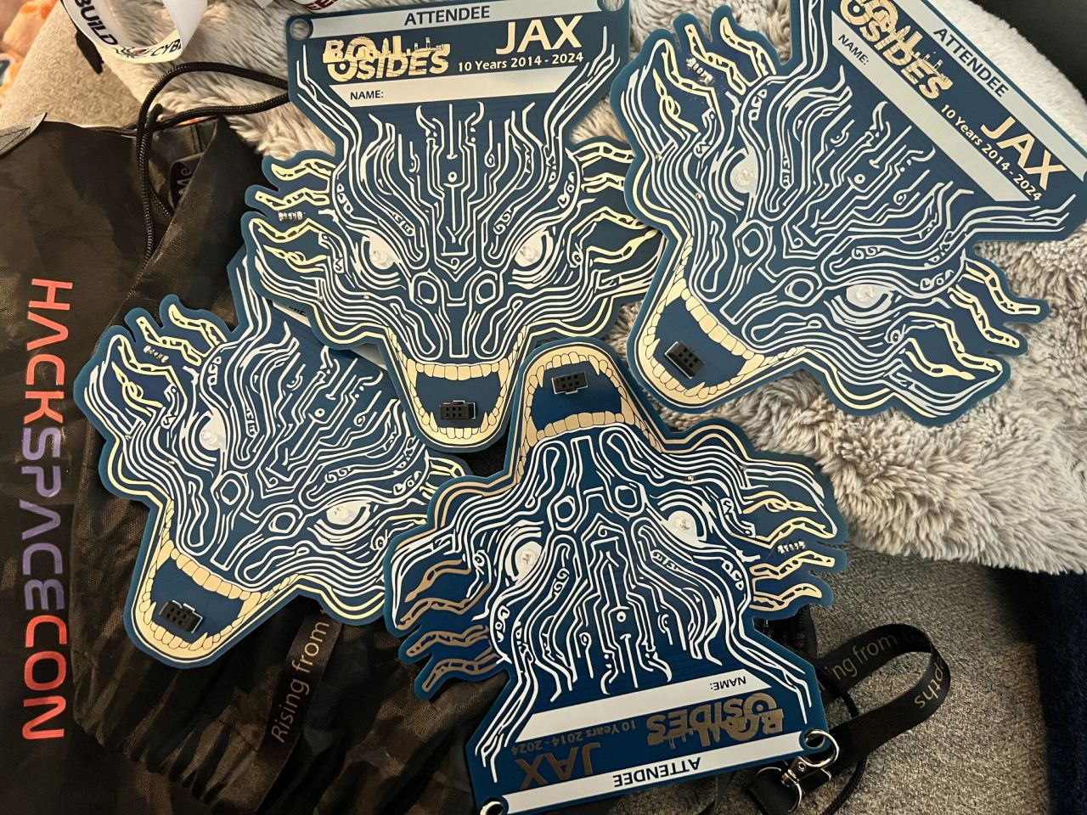
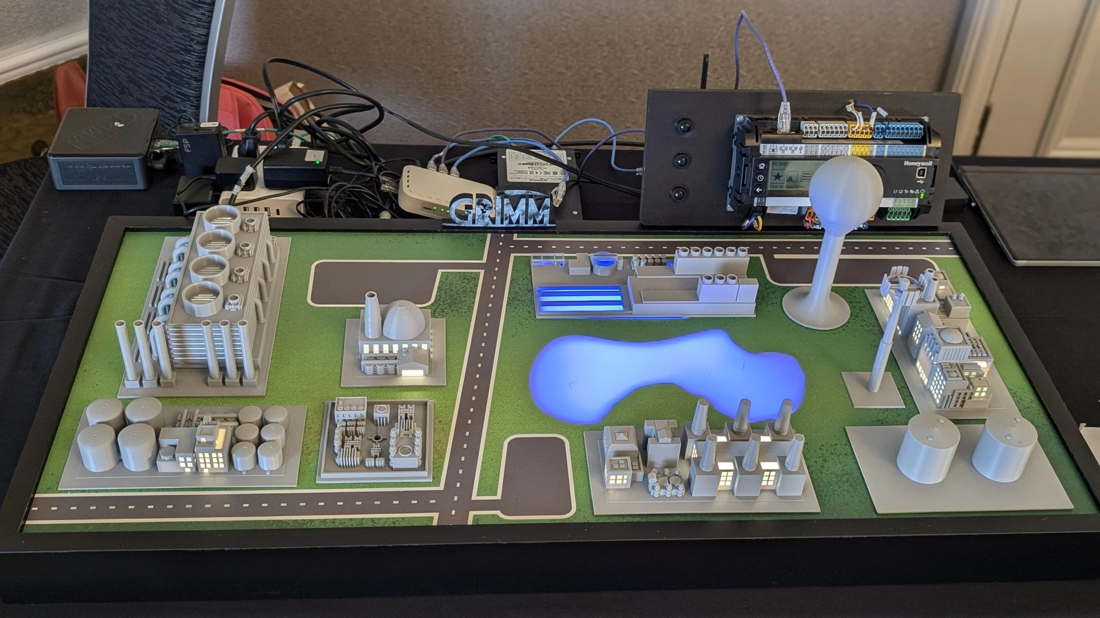
Infosec Community

Slide 6
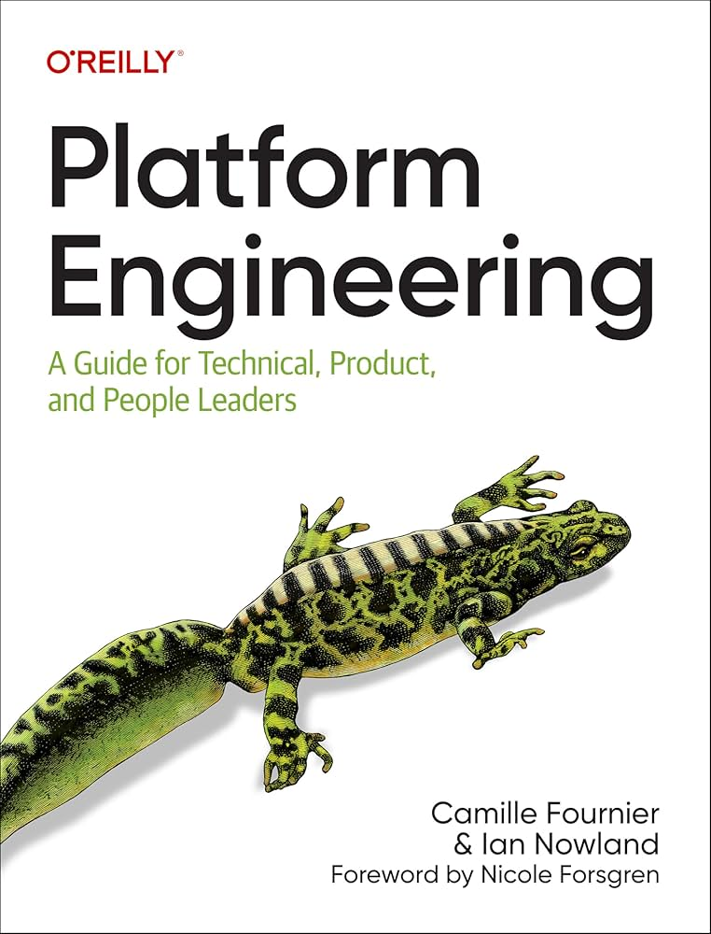
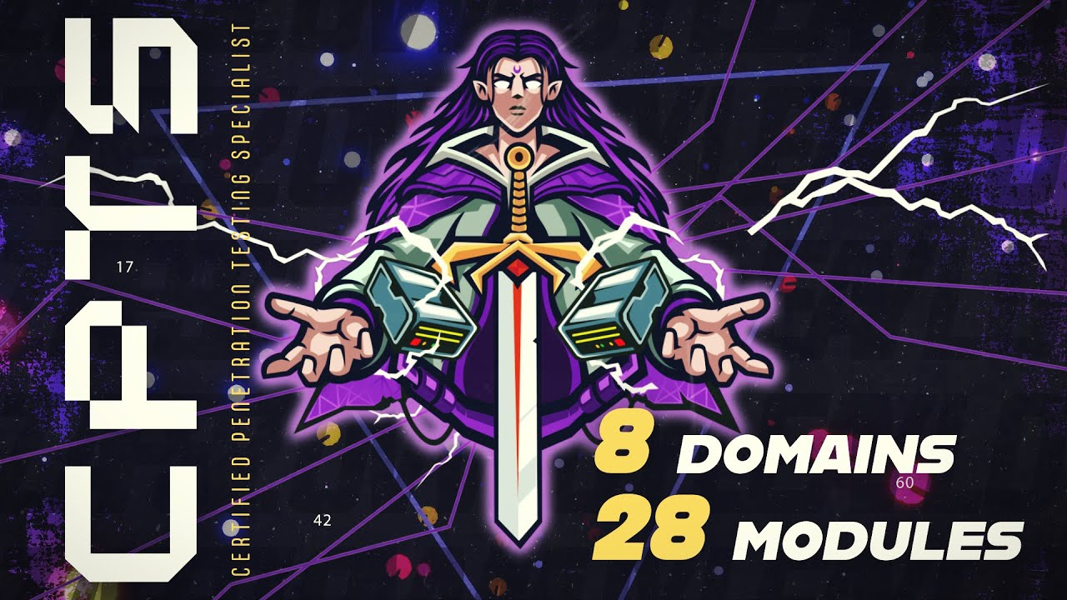
Where I Am Today

Slide 7


Goals

Slide 8
Wrapping up

Slide 9
Thank you

